Slide 1


Capstone Project - 4
Netflix Movies and TV Shows Clustering
Unsupervised Machine Learning
Presented By:
Ashwini R
Dhanraj S
Data Science Trainee, AlmaBetter

Slide 2
Table Of Contents
Defining problem statement
Data Cleaning & visualization
Data Pre-processing
Feature Selection
Applying different clustering methods
Applying Clustering Models
Conclusion

Slide 3
Problem Statement
This data-set consists of tv shows and movies available on Netflix as of 2020. The data-set is collected from Flexible which is a third-party Netflix search engine.
In 2018, they released an interesting report which shows that the number of TV shows on Netflix has nearly tripled since 2010. The streaming service’s number of movies has decreased by more
than 2,000 titles since 2010, while its number of TV shows has nearly tripled. It will be interesting to explore what all other insights can be obtained from the same data-set.

Slide 4
Data Summary
show_id : Unique ID for every Movie / Tv Show
type : A Movie or TV Show
title : Title of the Movie / Tv Show
director : Director of the Movie
cast : Actors involved in the movie / show
country : Country where the movie / show was produced
date_added : Date it was added on Netflix
release_year : Actual Release year of the movie / show
rating : TV Rating of the movie / show
duration : Total Duration - in minutes or number of seasons
listed_in : Genres
description: The Summary description

Slide 5
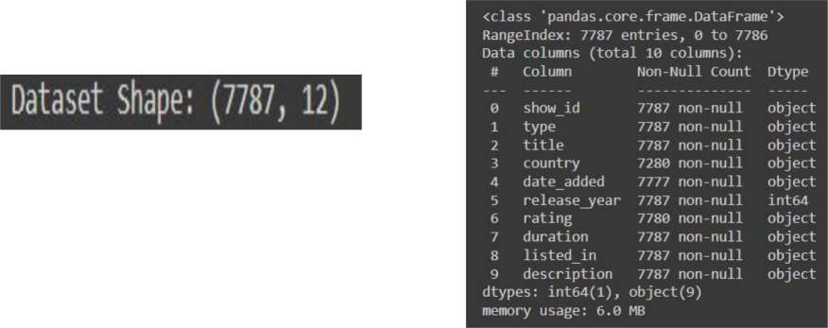
Basic Data Exploration
The dataset has 7787 observations and 12 features(columns).
The dataset consists of eleven textual columns and one numeric column(‘release_year’ )
No Duplicate values.

Slide 6
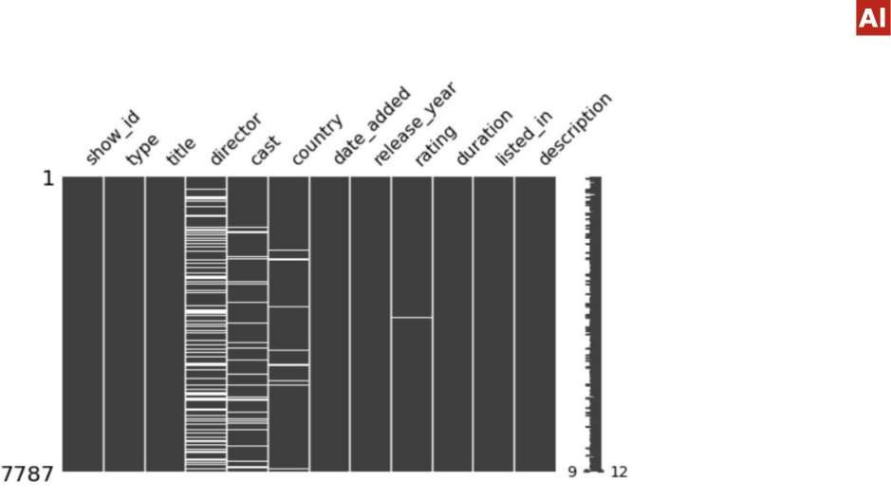
EDA (Checking NaN values)
Null values present in
this columns
  director
  cast
  country
  Rating
No missing value present
in this columns
  show_id
type
title
date_added
release_year
duration
listed_in
description

Slide 7
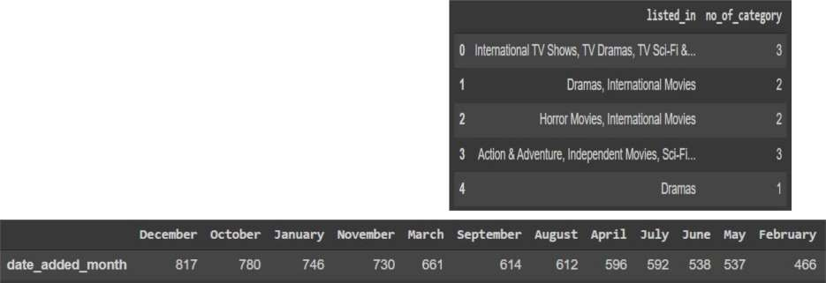
Data Cleaning
Removing unnecessary columns like 'director','cast'
Dropping all the NaN containing date_added observations(Only 10 observations was there )
Created 4 new columns
  No_of_categories based on listed_in
  Date_added_month based on date_added

Slide 8
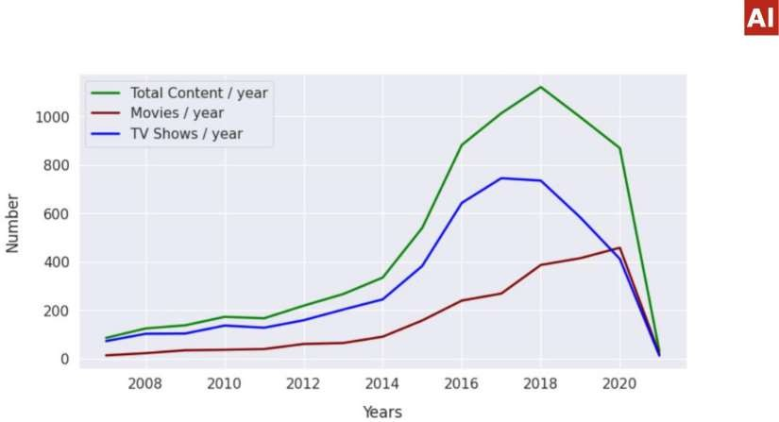
Production Yearly Growth
Can you say what’s the reason of that boom growth?

Slide 9
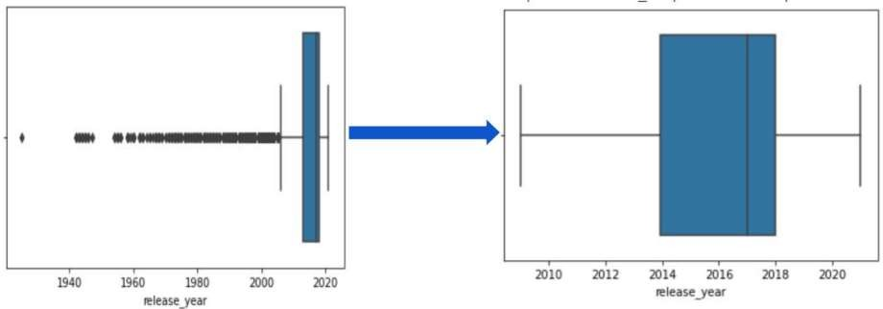
Checking Outliers
Replaced outliers values with mean value of release_year

Slide 10
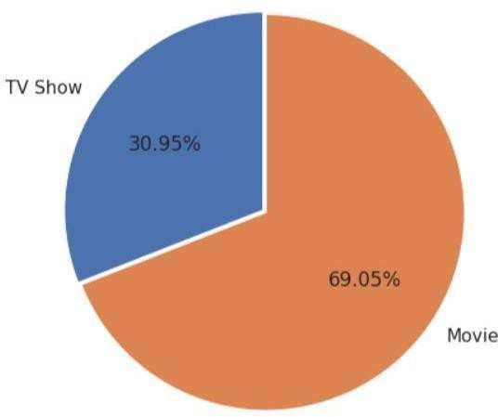
TV shows or Movies ??
Most of the contents are Movies
Less than ⅓ content are TV Shows

Slide 11
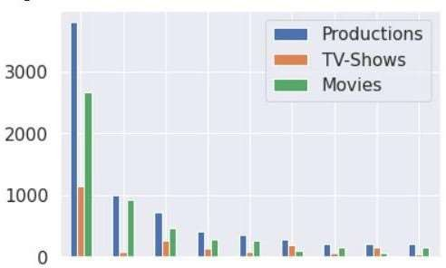
Countries producing most no of contents
United | India United Canada France Japan |  | South
States | Kingdom | Spain | Korea | Germany
United states have the most number of content and then india and so on
We can conclude that except Japan other countries are producing
movies more than TV- Shows

Slide 12
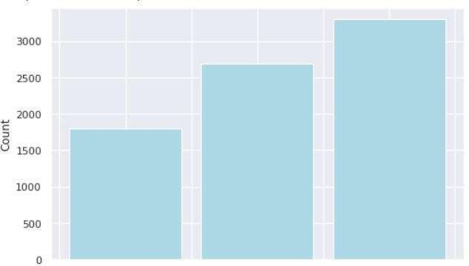
How many no of categories are present there in each content ?
1 2 3
no_of_category
Most of the movies are belonging to 3 categories

Slide 13
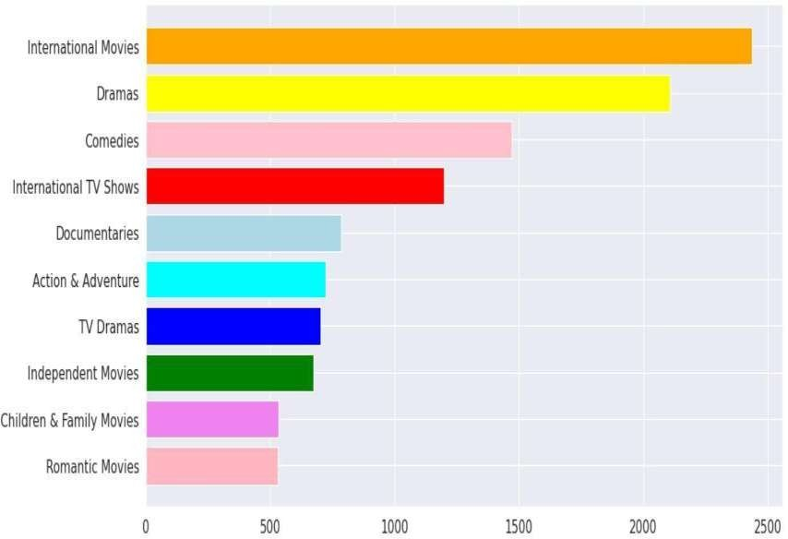
Top 10 Category For Contents

Slide 14
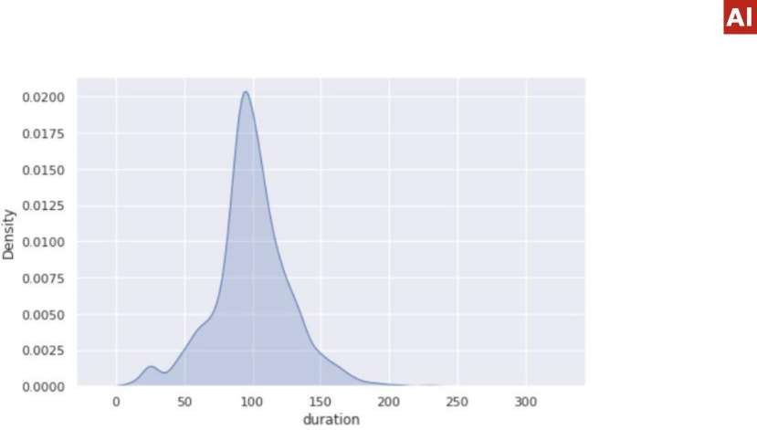
Movie wise density plot
Most movies are about 70 to 120 min duration for movies

Slide 15
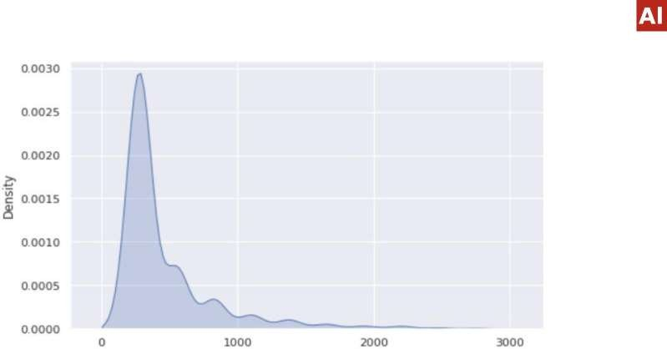
TV-Shows wise density plot
duration
Most contents are about 0 to 750 min duration for movies
There are very few shows which is having more than 1000 mins. (may be the no
of episodes/ seasons are more)

Slide 16
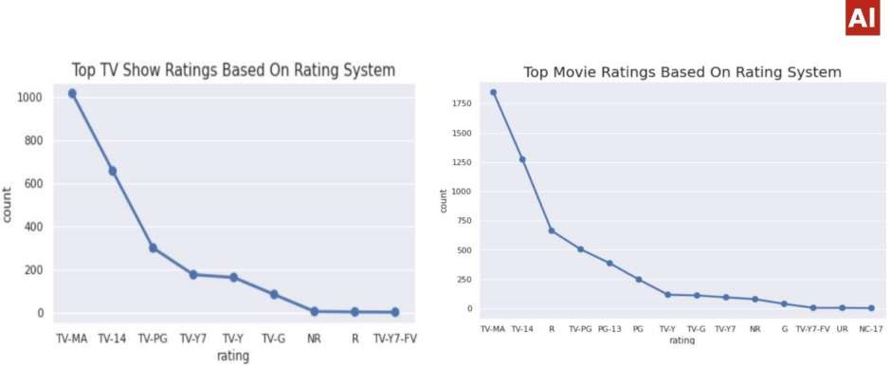
TOP Content Based On Rating
Most of the contents got ratings like
TV-MA (For Mature Audiences)
TV-14 ( May be unsuitable for children under 14 )
TV-PG ( Parental Guidance Suggested )
NR ( Not Rated )

Slide 17
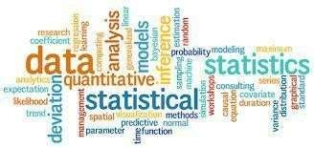

Word Cloud
What Is a Word Cloud?
A word cloud (also known as a tag cloud) is a visual representation of words. Cloud
creators are used to highlight popular words and phrases based on frequency and relevance. They provide you with quick and simple visual insights that can lead to more in-depth analyses.
Example →

Slide 18
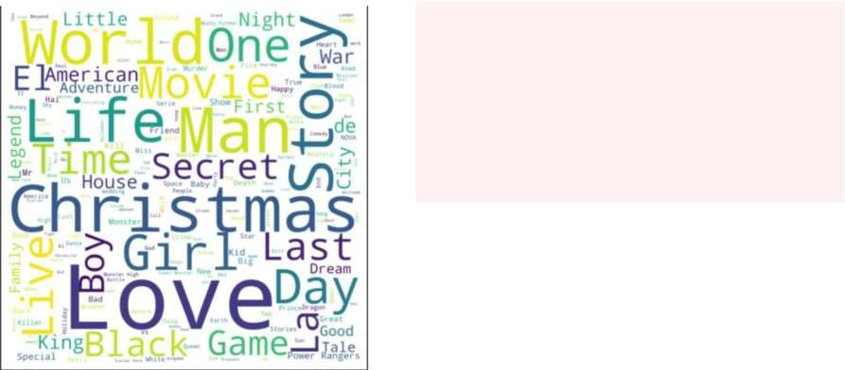

Applying WordCloud on Title
Most occurred words present in Title are:-
Love
Man
World
Story
Christmas
Girl
Day
Why Christmas occurred ?

Slide 19
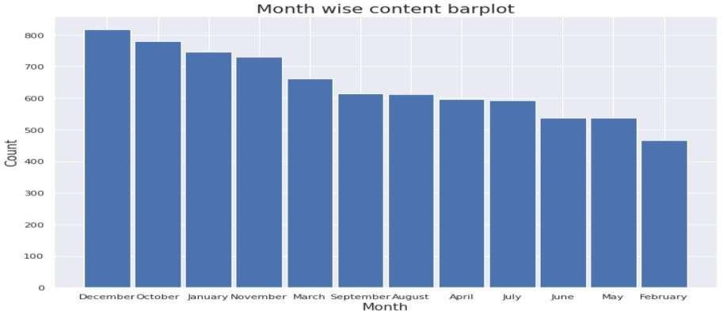
Barplot based on release month
We can say that December is the holiday season and it also has Christmas, so in that month most of the content got uploaded.

Slide 20
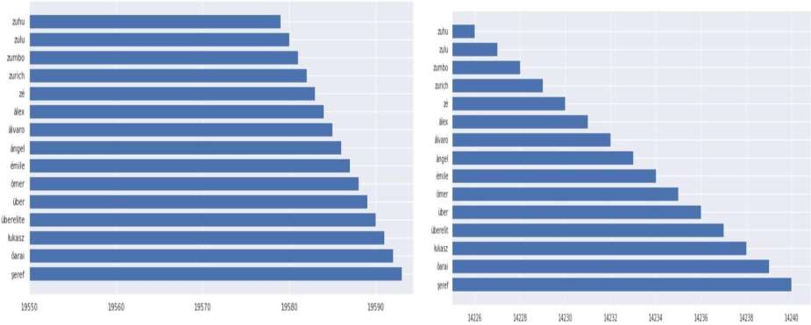
Before & After Stemming most occurred words in description

Slide 21
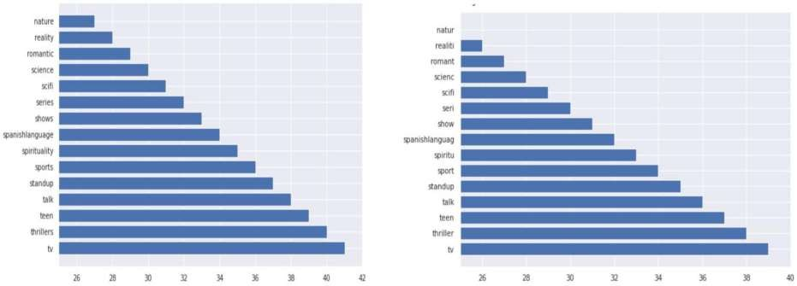
Before & After Stemming most occurred words
in listed_in

Slide 22


Feature Selection & ML algo used
Only selected 3 features , to do clustering
  no_of_category
  Length(description)
  Length(listed-in)
Using StandardScaler
Used 5 algo to find out best k value
  1. Silhouette score
  2. Elbow Method
  3. DBSCAN
  4. Dendrogram
  5. AgglomerativeClustering

Slide 23

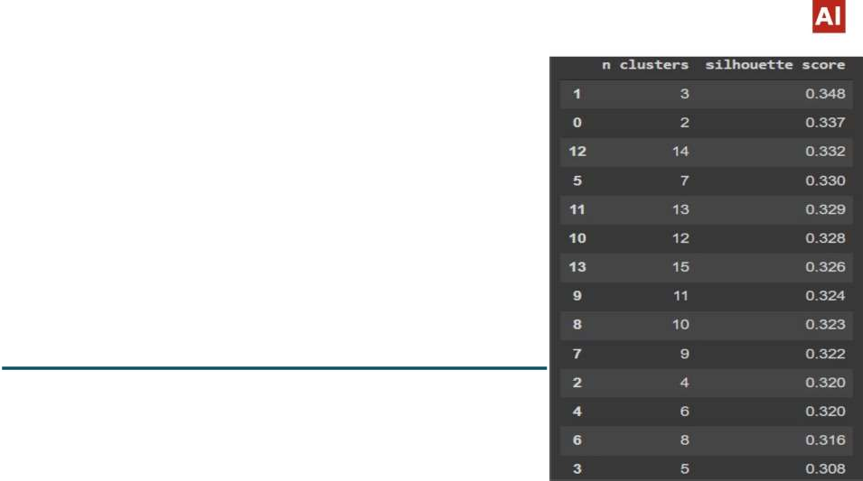


1. Silhouette Score
Silhouette Coefficient Formula
mean intra-cluster distance(a):- Mean distance between the observation and all other data points in the same cluster.
mean nearest-cluster distance (b) :- Mean distance between
the observation and all other data points of the next nearest cluster. This distance can also be called a.
The value of the silhouette coefficient is between [-1, 1]
If score is 1 denotes the best meaning that the data point i is very compact
within the cluster to which it belongs and far away from the other clusters.
The worst value is -1
If score is 0 denotes overlapping clusters

Slide 24
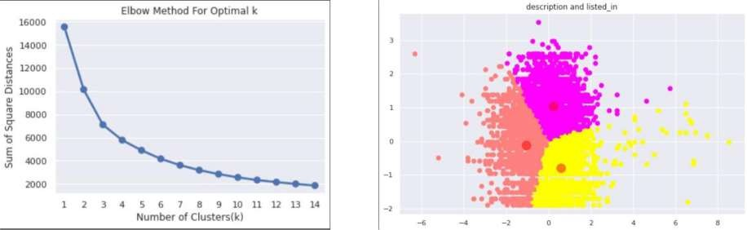
2. Elbow Method
The elbow method runs k-means clustering on the data-set for a range of values for k (say from 1-15) and then for each value of k computes WCSS value . By default, the distortion score is computed, the sum of square distances from each point to its assigned center.

Slide 25
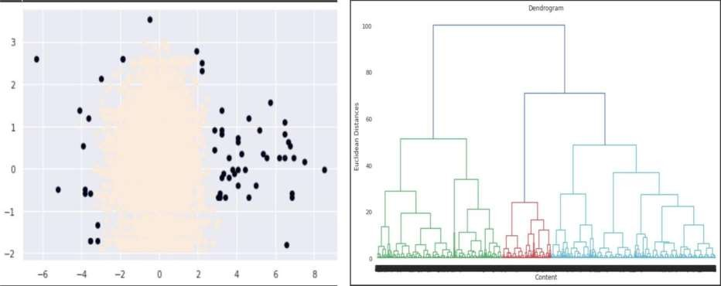
3 & 4 DBSCAN & Dendrogram
DBSCAN
Dendrogram

Slide 26
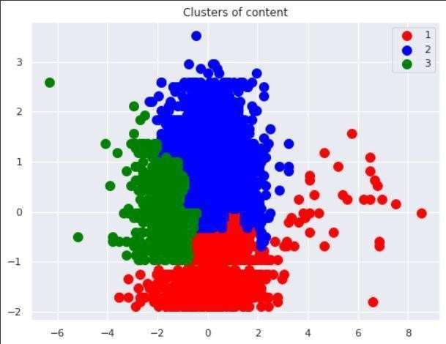
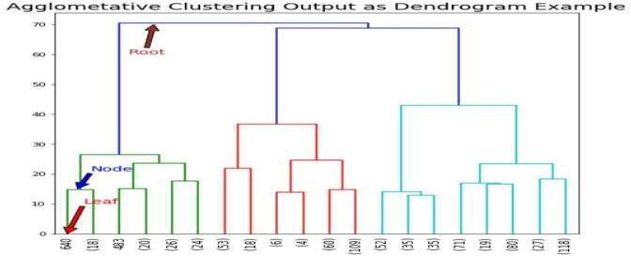
5 Agglomerative Clustering
Steps: -
Each data point is assigned as a single cluster.
Determine the distance measurement and calculate the
distance matrix.
Determine the linkage criteria to merge the clusters.
Update the distance matrix.
Repeat the process until every data point become one
cluster.

Slide 27
Conclusion
Director and cast contains a large number of null values so we will drop these 2 columns .
In this data-set there are two types of contents where 30.86% includes TV shows and the remaining 69.14%
carries Movies.
We have reached a conclusion from our analysis from the content added over years that Netflix is focusing movies and TV shows (From 2016 data we get to know that Movies is increased by 80% and TV shows is increased by 73% compare)
From the data-set insights we can conclude that the most number of TV Shows released in 2017 and for
Movies it is 2020
On Netflix USA has the largest number of contents. And most of the countries preferred to produce movies
more than TV shows.
Most of the movies are belonging to 3 categories
TOP 3 content categories are International movies , dramas , comedies.
In text analysis (NLP) I used stop words, removed punctuation's , stemming & TF-IDF vectorizer and other
functions of NLP.
Applied different clustering models like K-means, hierarchical, Agglomerative clustering, DBSCAN on data
we got the best cluster arrangements.
By applying different clustering algorithms to our data-set .we get the optimal number of
cluster is equal to 3

Slide 28
THANK YOU

